Slide 1
DevOps Gemeente Rotterdam
@MielDonkers

Slide 2
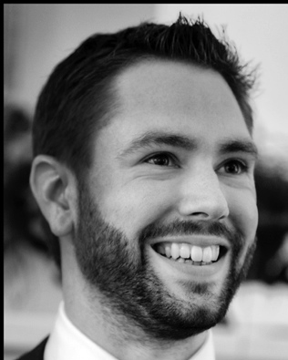
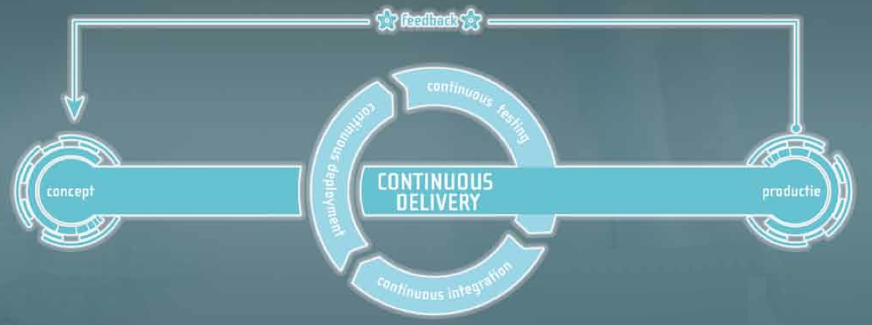
Introduction
Miel Donkers Developer
@mieldonkers

Slide 3
overview
Goal (why DevOps)
Execution
Personal recommendations
Notes:
3

Slide 4
ING‘s goal
Faster in production
Quality
Customer satisfaction
Notes:
4

Slide 5
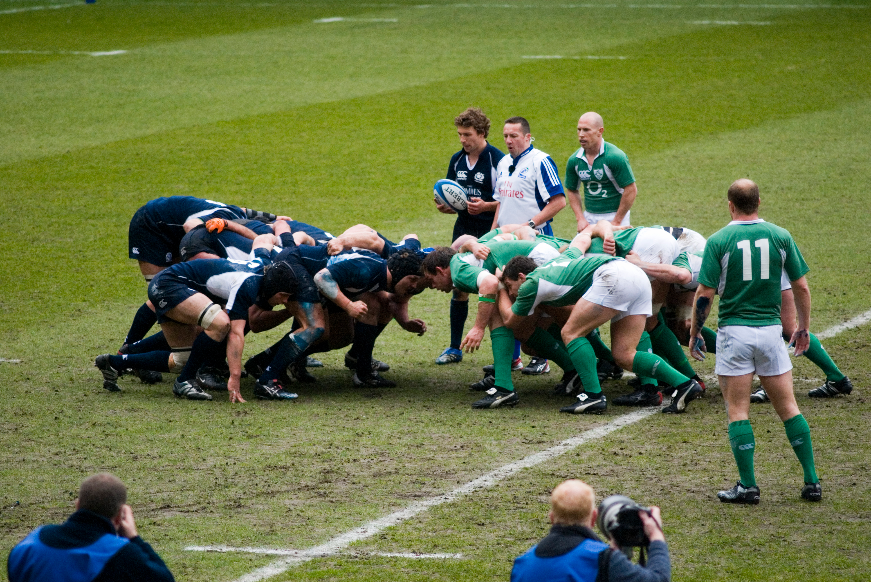
2010: Scrum
Notes:
Coaching
Team samenstelling
Dingen uitproberen

Slide 6
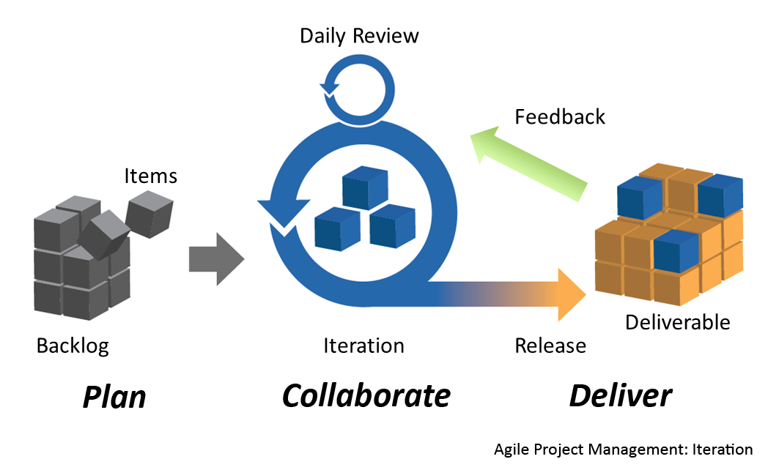
Notes:
6

Slide 7
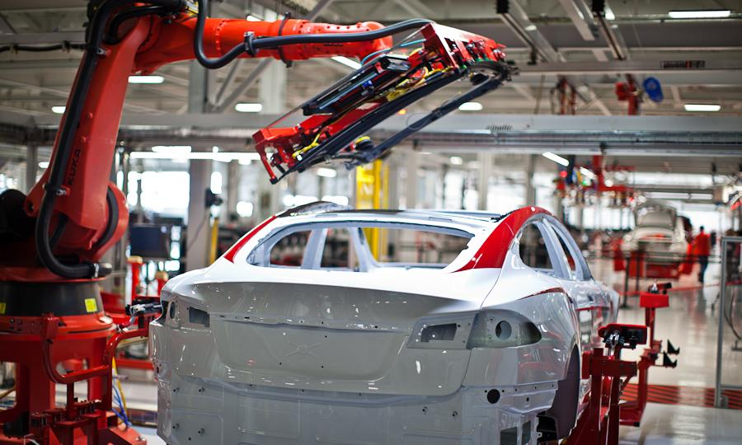
2011: Continuous Delivery

Slide 8
Continuous Delivery - deployment pipeline
Fast Feedback
Done
Commit
Automated
Acceptance Test
Automated
Capacity Test
Manual
Testing
Release
Trust in Application Stability
Every change results in a trigger of the deployment process
Software is build once and only once
The same deployment process for every environment
Deployment in production-like environments
Notes:
8
C : Compile, Unit Test, Software Qualität (), unter 10 Minuten --> Schnelles Feedback an den Entwickler
AAT : Automatisierte Akzeptanz und Komponente-Tests, Funktionale Spezifikation, Kosten/Nutzen!
ACT : Nichtfunktionale Anforderungen, Performance, Security, ins besonders SLAs
MT : Pull Prinzip, kein Warten auf einen „guten“ Build, Showcases , Exploratives Testen, Bestätigung der Qualität --> Fokus nicht mehr Regressionstests, sondern auf neue Features
R :
Binaries : Unterschiedliche Compiler, Zeitersparnis, Flexibilität,

Slide 9
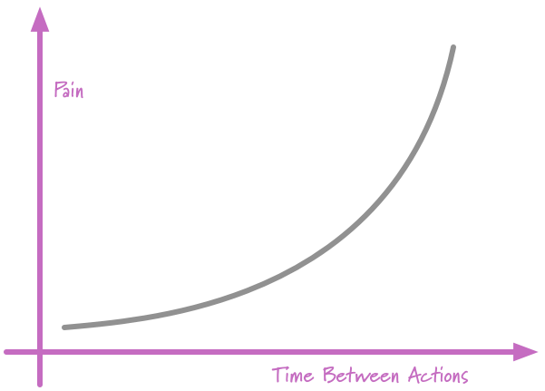
Principle
if it hurts
do it more often!
Notes:
9

Slide 10
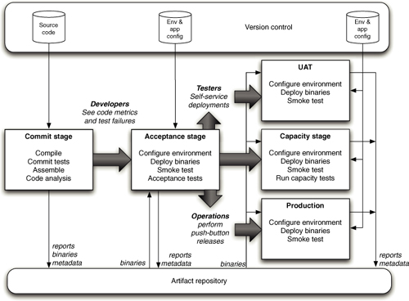
Deployment environments
1
2
3
Notes:
Continuous delivery langzaam ingevoerd, stap voor stap.

Slide 11
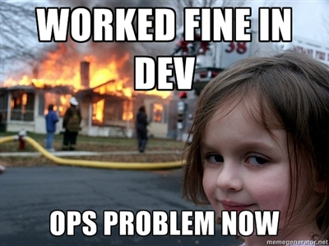

Slide 12
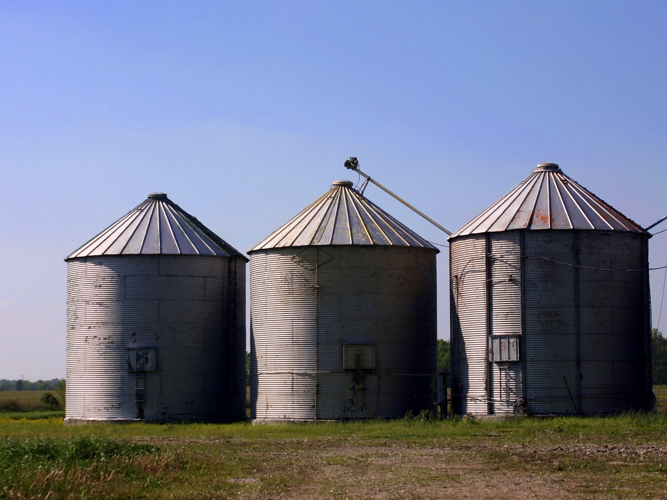

Slide 13
Silos
Business
Development
Operations

Slide 14
Silos when doing scrum
Business
Agile Development
Operations
Product Owner

Slide 15
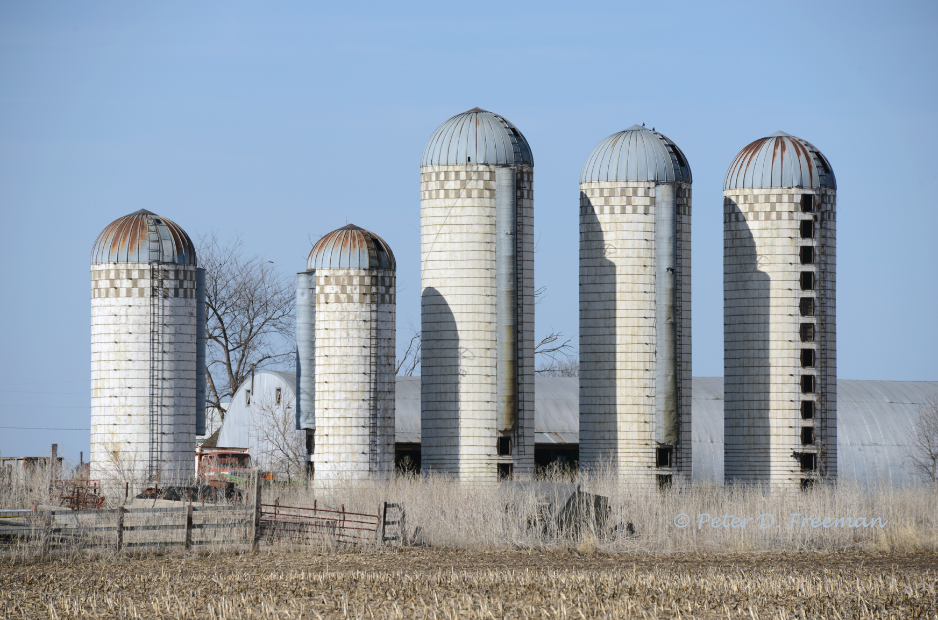

Slide 16
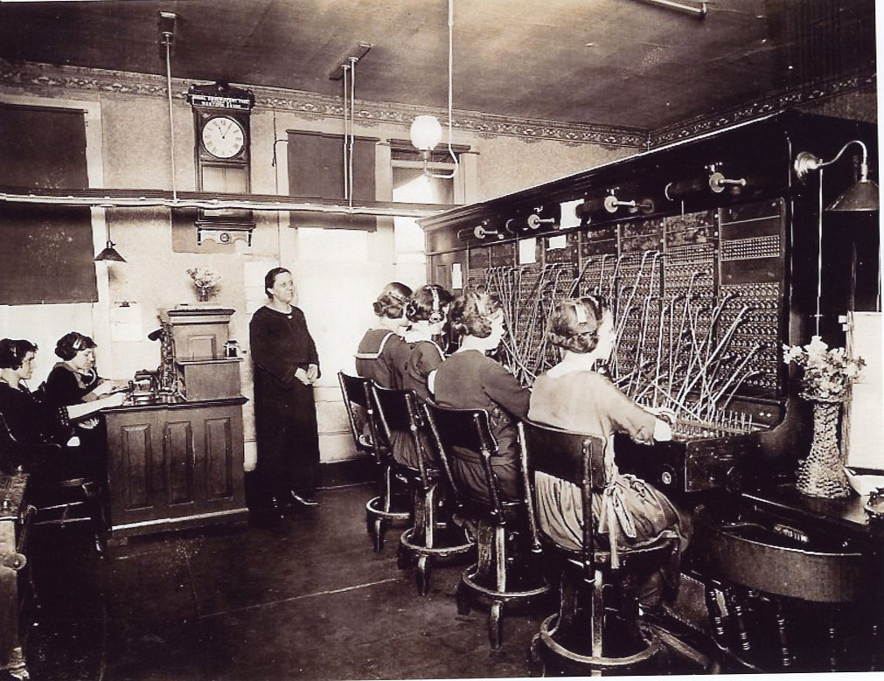

Slide 17
Ing Departments
Security
Operations
Business
Development
Legal
…
Product Owner
Security
…
Operations
…

Slide 18
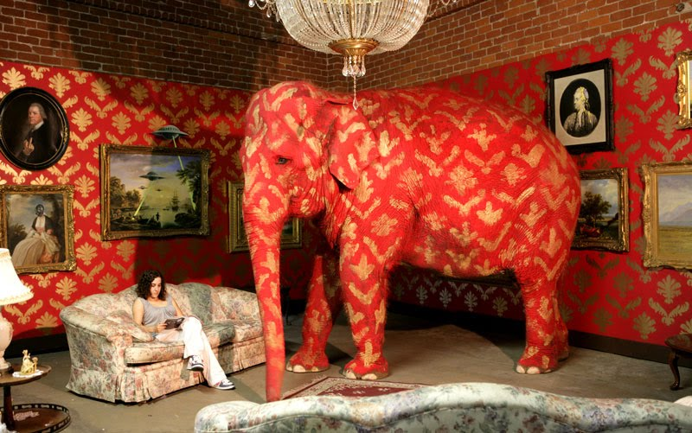
Overlooked problem

Slide 19
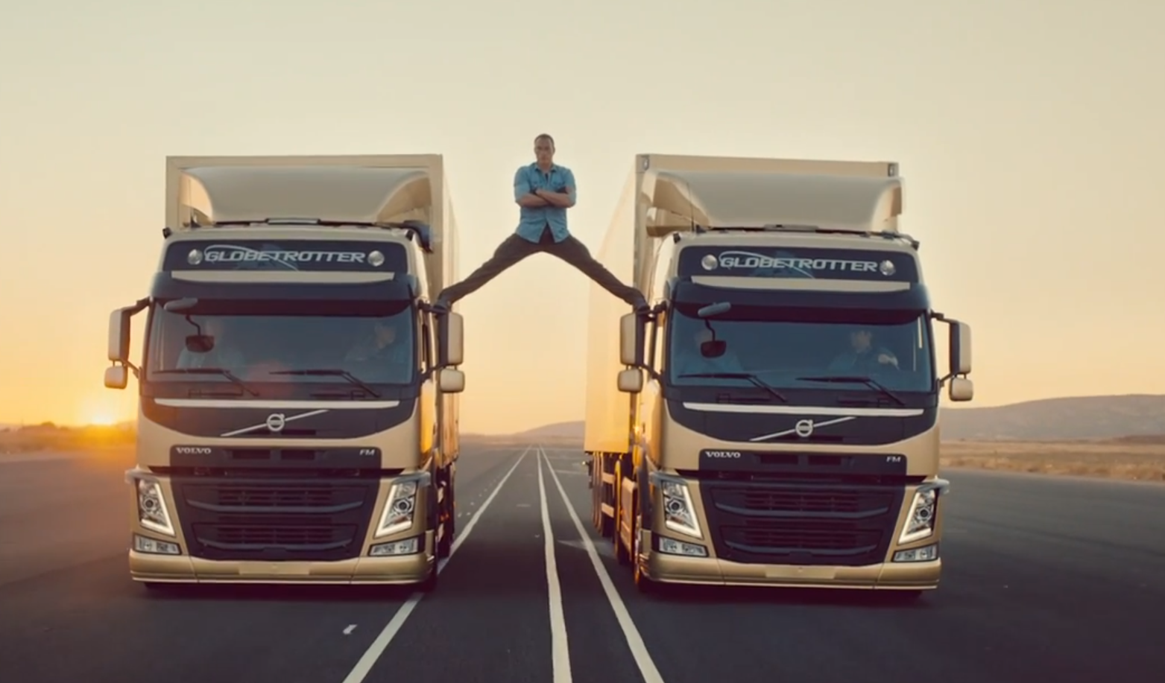
Change vs. Stability

Slide 20


Slide 21
Devops teams
Business
DevOps
Product Owner
Dev
Security
Ops
Test
…

Slide 22

teamwork
Prod
Local Build
Intermediate build
Release build
Acc
Develop
Verify
Verify
Install
DEV
TEST
OPS
OPS

Slide 23
Responsibilities
Apps / Services / Components | Application Configuration
Middleware | Middleware Configuration
Operating System | OS Configuration
Hardware
Full Stack

Slide 24
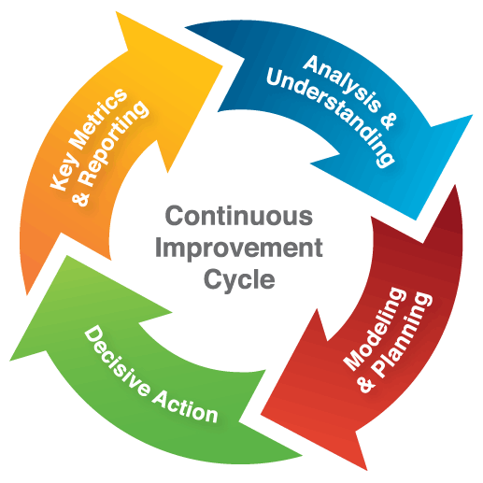
Principle
Continuous Improvement
Notes:
24

Slide 25
!= Devops
No specific ‚way of working‘ or methodology
No job title or group name
No Devs doing Ops‘ tasks

Slide 26

Execution

Slide 27
The Good
Good composition of team members
Cooperation and task division

Slide 28
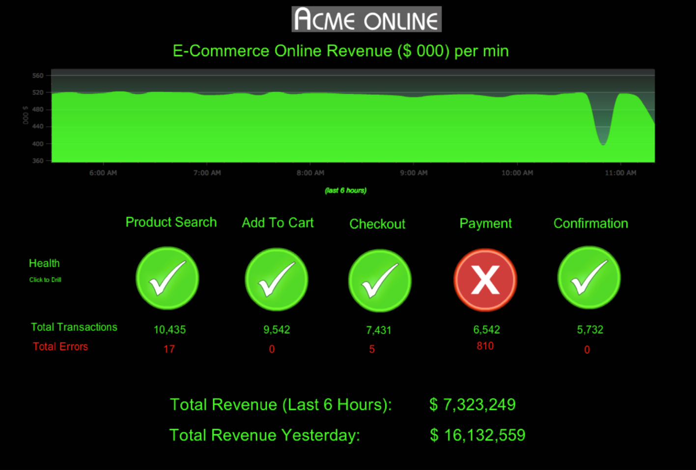
Dashboards

Slide 29
Sprint Board
DevOps
I
% Ops tasks for the team
% Ops tasks outside the team
ToDo In Progress Done
Fast Lane
In Sprint
II
Way of Working
Fast Lane
Work in de sprints

Slide 30
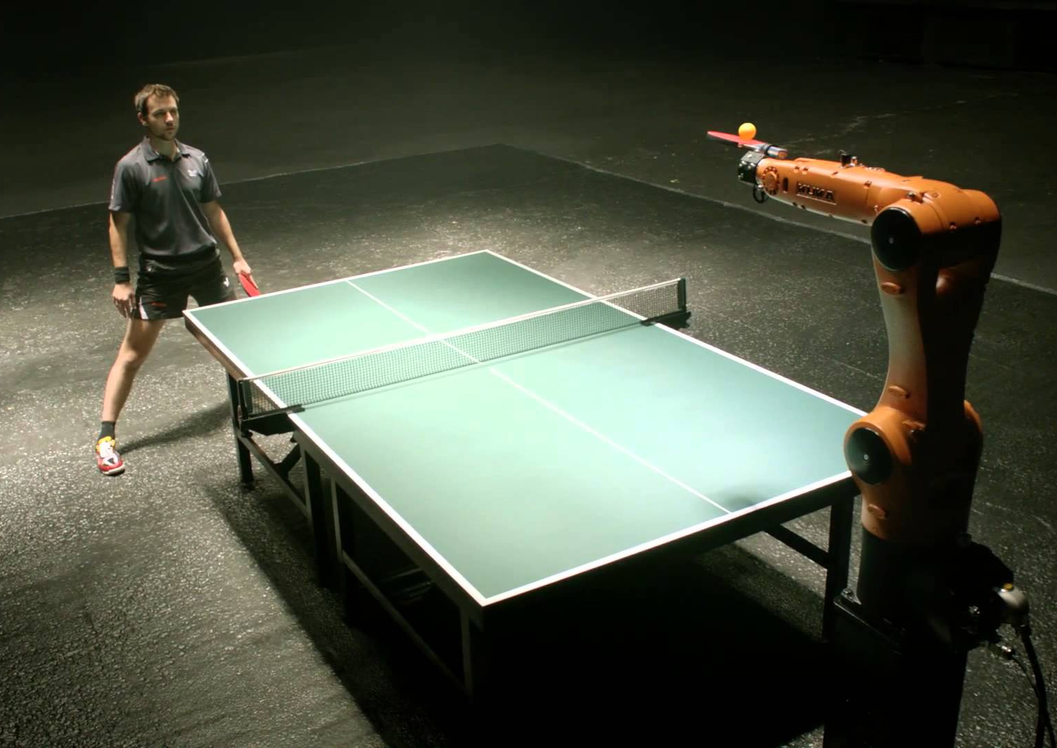
Automation

Slide 31
The Bad
Many (Ops) tasks not visualized
ING organisation
Many impediments
Distance between locations / offices

Slide 32

Product Backlog

Slide 33

24/7 Support
Notes:
33

Slide 34
The Ugly
Change of team composition after 3 months (by management)

Slide 35


Slide 36
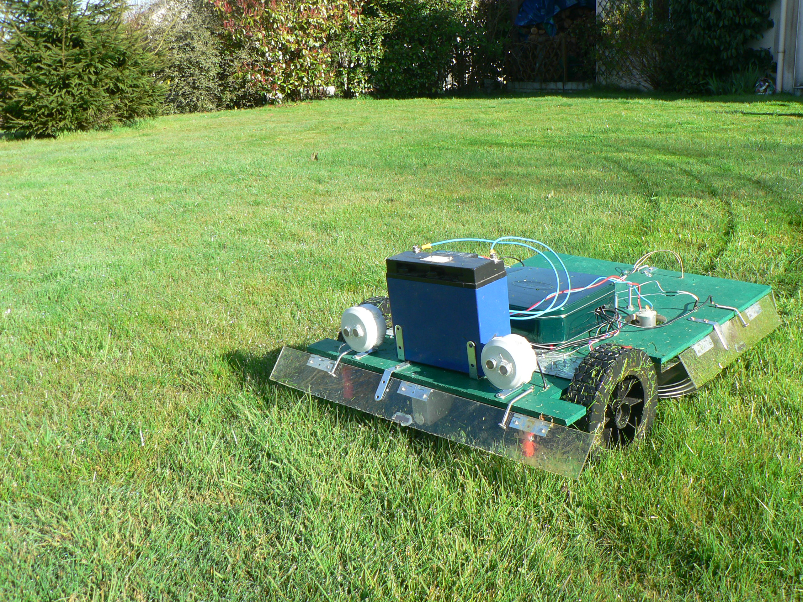
Automate routine tasks

Slide 37
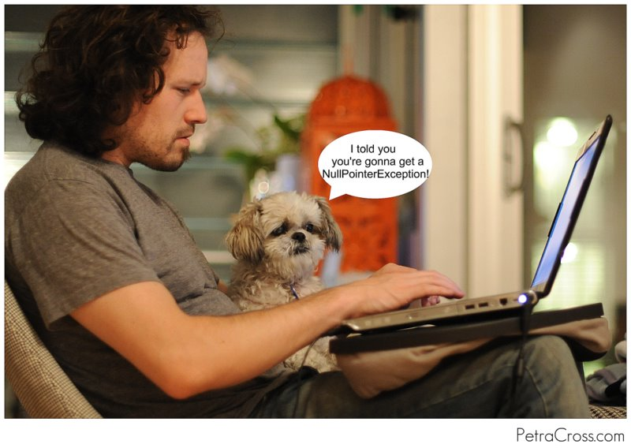
Pairing

Slide 38

Time to improve

Slide 39
Agreements
Between team and product owner about:
How to handle production incidents
How to handle bugs
When to upgrade
Non-functional requirements
Notes:
39

Slide 40

Continuous Delivery
Thank you for your attention
Notes:
40

Slide 41
Contact Information
Miel.Donkers@codecentric.nl
+31 (0) 6511 977 38
@mieldonkers
See our website for more information:
http://www.codecentric.nl/portfolio/continuous-delivery/
Notes:
41

Slide 42
Dev Ops
DevOps: iedereen is Dev EN Ops

Slide 43
Change Stability
De echte scheiding is: Changes vs Stability (24/7)

